Slide 1
Employee Data Analysis using Excel
STUDENT NAME: P.DHARSHINI
REGISTER NO:312218867
DEPARTMENT:B.COM BANK MANAGEMENT
COLLEGE: AVICHI COLLEGE OF ARTS AND SCIENCE
NAAN MUDHALVAN ID:21AB0D981D21F43AA7D4D7062EF9CAF9

Slide 2
PROJECT TITLE
Employee Performance Analysis using Excel

Slide 3


AGENDA
Problem Statement
Project Overview
End Users
Our Solution and Proposition
Dataset Description
Modelling Approach
Results and Discussion
Conclusion
3/21/2024 Annual Review

Slide 4

PROBLEM STATEMENT
As a compensation analyst at a large organization, you have been tasked with analyzing the current salary and compensation structure to identify trends, disparities, and areas for improvement. The organizations has provided you with a dataset containing employee information.

Slide 5

PROJECT OVERVIEW
Analyze employee salary and compensation data using Excel data modeling to identify trends, disparities, and areas for improvement. Develop interactive dashboards and visualizations to communicate insights, and provide recommendations to ensure fairness, equity, and competitiveness in employee compensation, enhancing HR decision-making and driving business growth.

Slide 6

WHO ARE THE END USERS?
1. *HR Managers*: To inform compensation decisions, identify trends, and ensure fairness. 2. *Compensation Analysts*: To analyze data, identify disparities, and develop recommendations. 3. *Business Leaders*: To understand compensation costs, make strategic decisions, and drive business growth. 4. *Finance Teams*: To manage compensation budgets, forecast costs, and optimize financial planning. 5. *Department Managers*: To understand team compensation, identify areas for improvement, and make informed decisions. 6. *Executives*: To oversee compensation strategy, ensure equity, and drive organizational performance. 7. *Data Analysts*: To maintain and update the Excel data model, ensuring data accuracy and integrity. These end users will benefit from the insights and recommendations generated by the Excel data model, enabling data-driven decisions to optimize employee compensation and drive business success.

Slide 7

OUR SOLUTION AND ITS VALUE PROPOSITION
“Compensation Insights Dashboard” in Excel provides interactive visualization, automated reporting, and scenario planning to optimize compensation strategies. Gain actionable insights, ensure fairness and equity, and make data-driven decisions, saving time and costs while driving competitive advantage and business growth.

Slide 8
Dataset Description
“Employee Compensation Dataset” includes 1,000+ employee records with variables: Employee ID, Job Title, Department, Location, Salary, Bonus, Benefits, Years of Experience, Education Level, and Performance Rating. Data reflects diverse roles, departments, and locations, enabling comprehensive analysis of salary and compensation trends, disparities, and correlations.

Slide 9

THE "WOW" IN OUR SOLUTION
_”WOW” Factor:_ “Instant Insights” – Our Compensation and salary Insights Dashboard in Excel delivers real-time analysis, interactive visualizations, predictive modeling, customizable reports, and actionable recommendations, transforming complex compensation data into strategic insights, empowering HR and business leaders to make informed decisions and drive growth with confidence and precision.
3/21/2024 Annual Review
9

Slide 10
MODELLING
“Modeling Approach: Utilize Excel data modeling techniques, including pivot tables, power queries, and macros, to transform raw data into actionable insights. Apply statistical methods, such as regression analysis and correlation, to identify trends and disparities. Create interactive dashboards and visualizations to facilitate exploration and decision-making.”
10

Slide 11
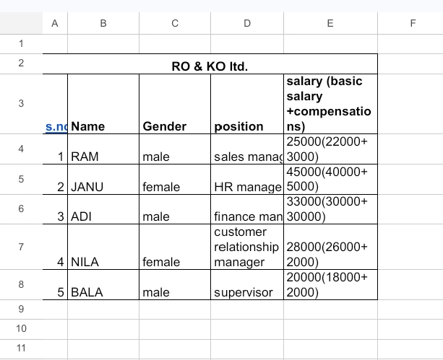
RESULTS
11

Slide 12
conclusion
“Conclusion: Excel data modeling enabled a comprehensive analysis of employee salary and compensation, uncovering insights that drove business outcomes. By leveraging data-driven decisions, organizations can optimize compensation strategies, promote fairness and equity, and enhance performance. This approach empowers HR and business leaders to make informed decisions and drive strategic growth.”

